Slide 1
Non-Hydrodynamic Modes in Kinetic Theory
Stephan Ochsenfeld

Slide 2
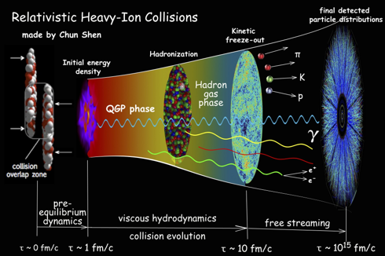
The Problem
Still unclear “when” hydrodynamics is good description
Hydro is late time and long wavelength limit

Slide 3
What is Hydro?
Hydrodynamics is driven by conservation laws
Now how do these quantities look like?
Perfect fluid
Viscous fluid
Dissipative part contains gradients of hydrodynamic fields
(Navier-Stokes is first order gradients)

Slide 4
Why use modes?
Modes are the eigenvalues of differential equations in Fourier space, e.g. Navier Stokes
Real part is oscillation, imaginary part is decay
Look at time evolution of observables in position Fourier space
Modes contain all possible ways the medium can respond

Slide 5
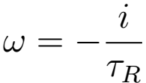
What does non-Hydro mean?
Everything that is not hydro
Simple example, RTA for k=0
Also predominant for large k → gives us boundaries for Hydro
Hydro
Non-Hydro

Slide 6
How do we analyze Modes?
Use effective kinetic theory for equilibrium background and calculate linear response to perturbations
C contains underlying microscopic theory
Take k in z-direction and linearize
Find all possible modes, compare their residues

Slide 7
How to really find Modes
Either calculate eigenvalues directly or find singularities in Green’s functions
Analytical solutions are rarely an option for complex theories
Calculate real time Green’s functions numerically and Laplace transform? No! Does not work for more than one singularity
Get creative!

Slide 8
Possibility 1: Analytic Calculation
Only if possible, e.g. Relaxation Time Approximation
Introduce source term, e.g. small external field
Moments of distribution → Energy Momentum Tensor or Charge Vector
[Romatschke, EPJ C(2016)]

Slide 9
Possibility 1: Analytic Calculation
[Romatschke, EPJ C(2016)]
Moments of distribution function build energy momentum tensor or charge current
Green’s function via functional derivative
One mode and branch cut from to

Slide 10
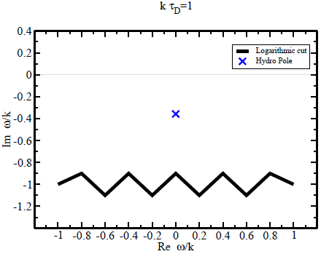
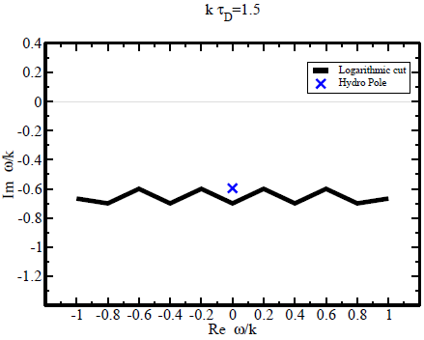
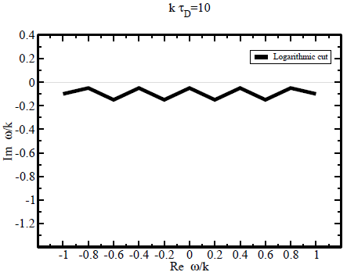
Possibility 1: Analytic Calculation
[Romatschke, EPJ C(2016)]
Hydro mode approaches cut
At some k gets ‘swallowed’ by cut
Simple structure: one pole, one cut

Slide 11
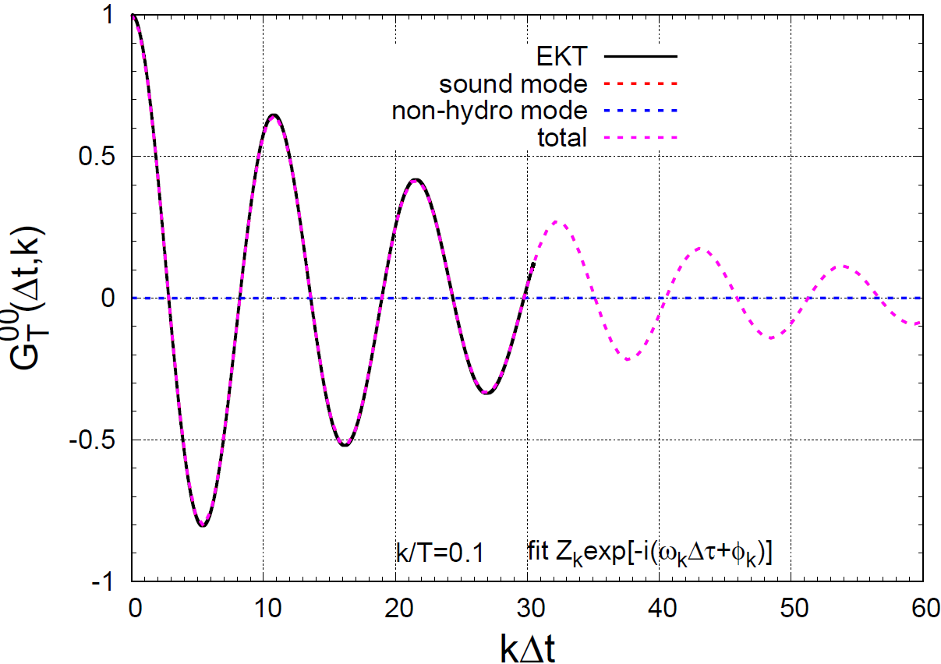
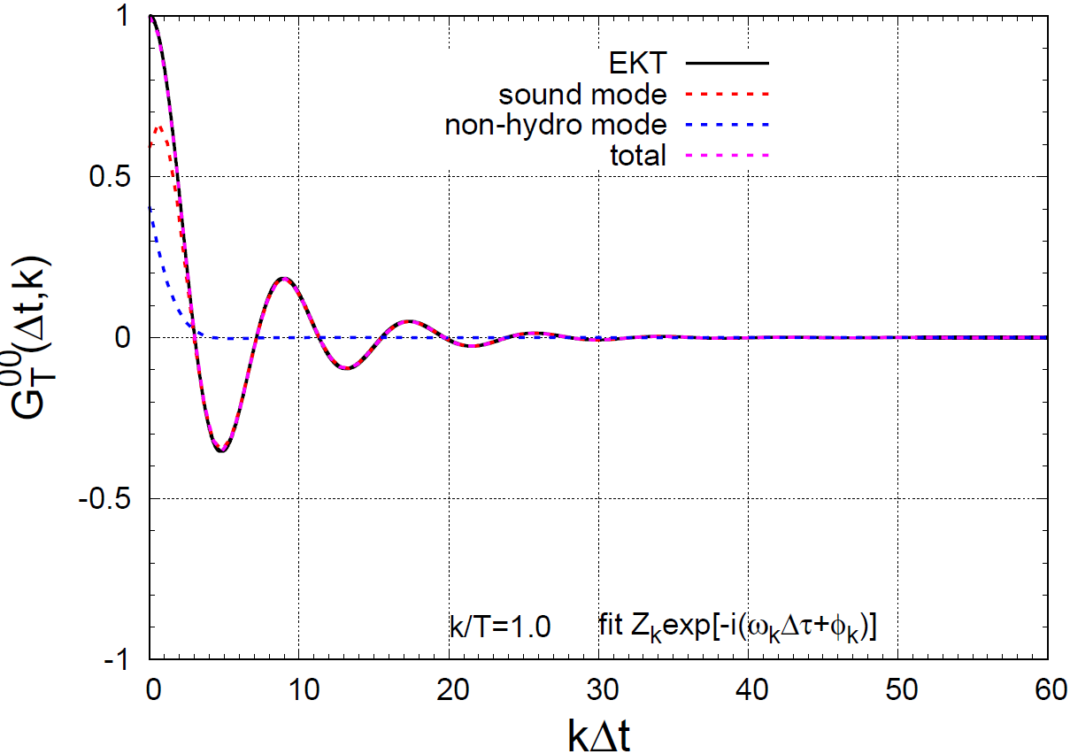
Possibility 2: Fitting
Assume we only have two modes, Hydro and non-Hydro
Limited range of validity because of strong constrains
Fit Hydro mode at late times ( ) and add non-Hydro
Yang-Mills

Slide 12
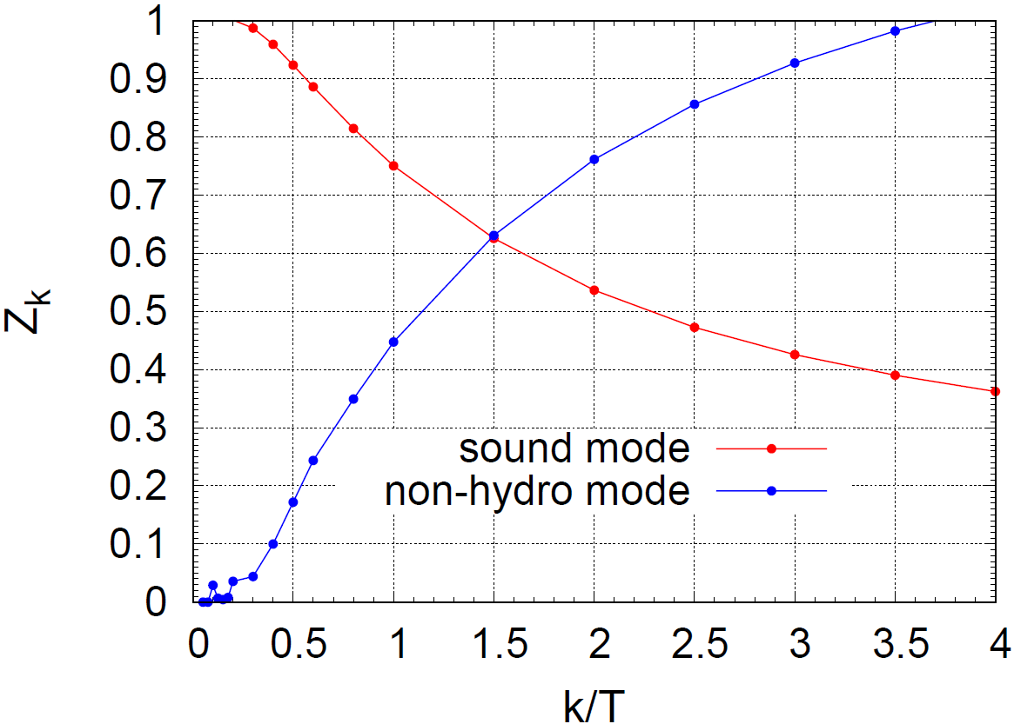
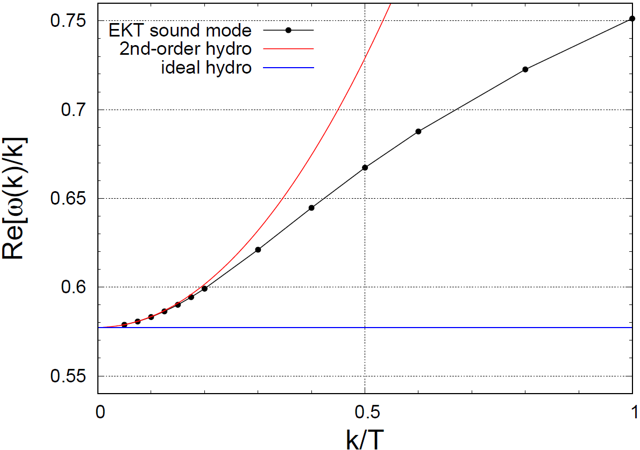
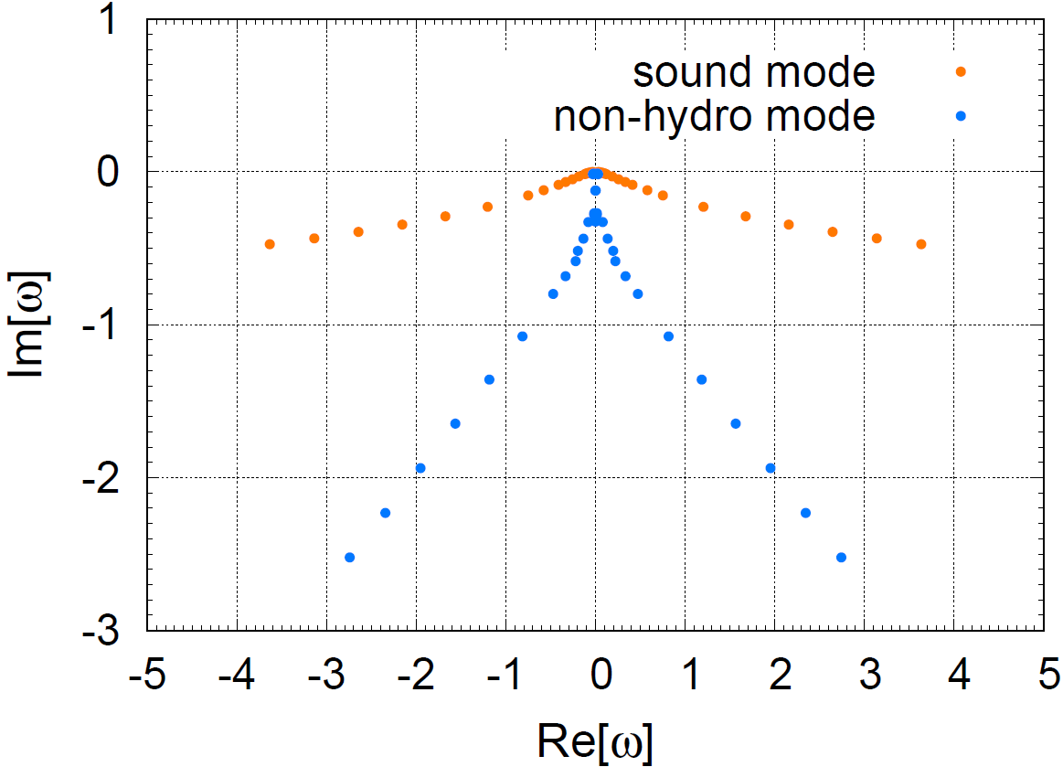
Possibility 2: Fitting
Analyze multiple k and compare to Hydrodynamics
Range of applicability of hydrodynamics
Deviation from hydrodynamic theory

Slide 13
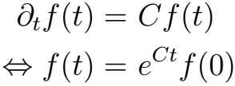
Possibility 3: Eigenvalues
Basic Operator equation reads eigenvalues easily
Eigenvalues given by operator C
Numerically operator → finite dimensional matrix distribution function → finite dimensional vector
We have to translate Boltzmann equation into matrix vector equation

Slide 14
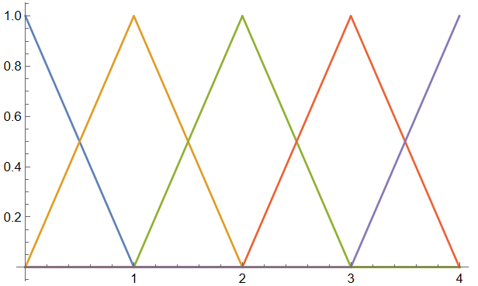
Possibility 3: Eigenvalues
Build moments of distribution function on a grid of momenta and angles
Inverse function from vector to distribution

Slide 15
Possibility 3: Eigenvalues
Build matrix from moments of collision integral
Collision kernel is linear in and thus in
Matrix from functional derivative
Do the same with in Boltzmann equation

Slide 16
Possibility 3: Eigenvalues
Solution is simply
Green’s functions built from moments, e.g. energy
From that, observable can be represented by vector in moment space
If we know eigenvalues diagonal representation of matrix can be used

Slide 17
Possibility 3: Eigenvalues
Every eigenvalue has a certain weight depending on observable and initial condition (remember residue earlier)
Quasi analytic form allows Laplace transform
Now equipped to find G at every time or frequency and analyze single eigenvalues via weight

Slide 18
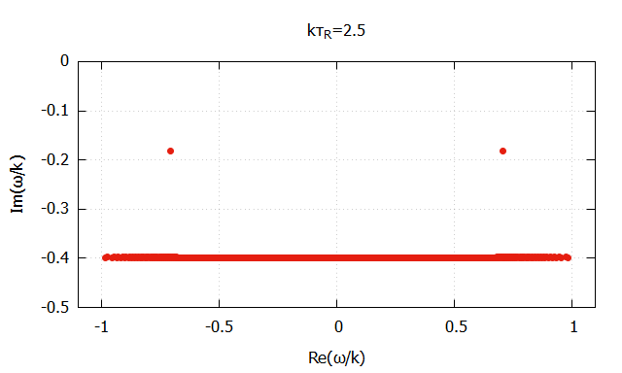
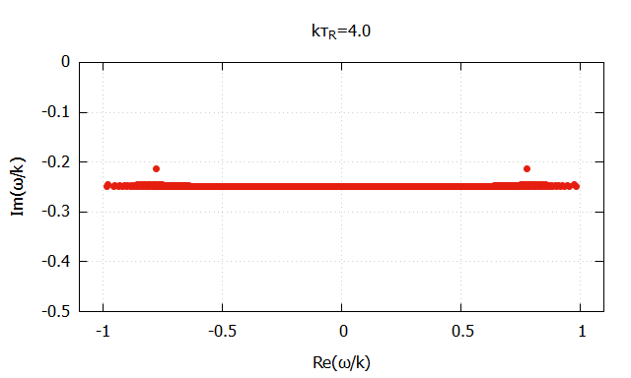
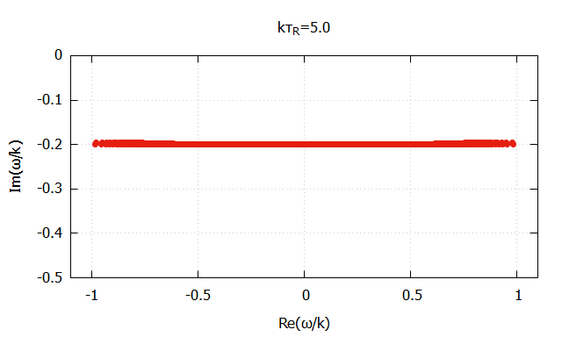
Possibility 3: Eigenvalues | Benchmarking
Test the method with RTA, energy used here
Cut appears as line of eigenvalues
Two hydro poles vanish behind non-Hydro cut

Slide 19
Possibility 3: Eigenvalues | Scalar Theory
Scalar quartic theory as final test for method ( )
Matrix calculated with Monte-Carlo integration in high precision and can be stored for multiple uses
Vary k and analyze behavior

Slide 20
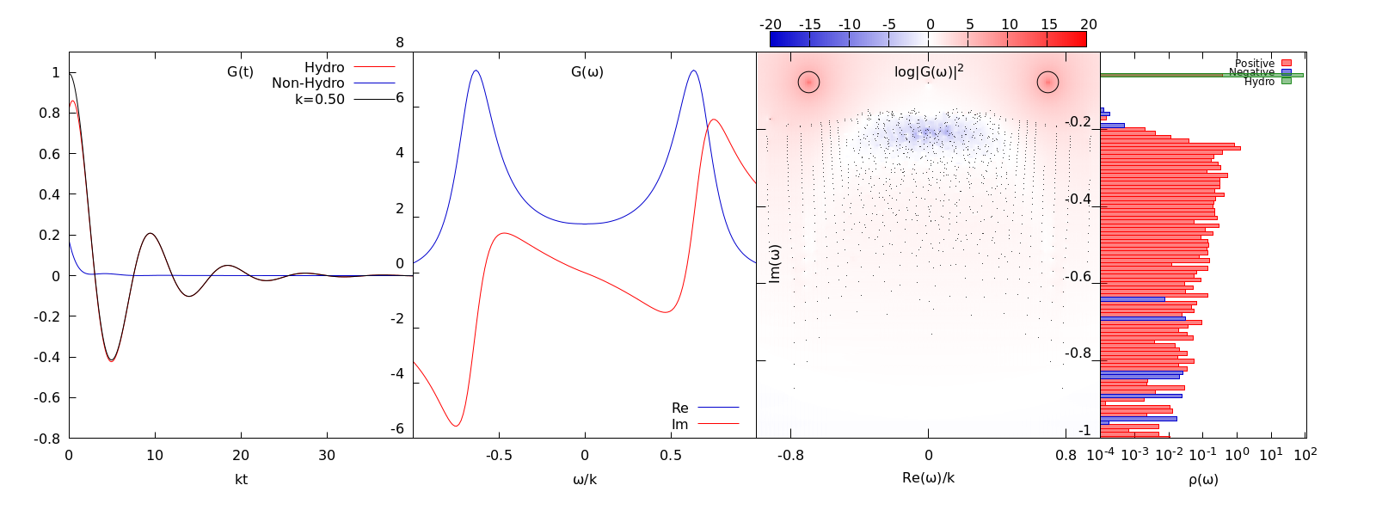
Possibility 3: Eigenvalues | Scalar Theory
Defining Hydro numerically very hard, for now the two largest poles

Slide 21
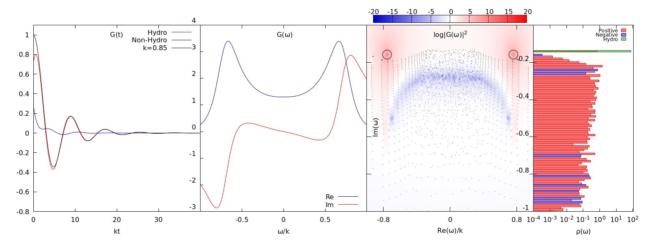
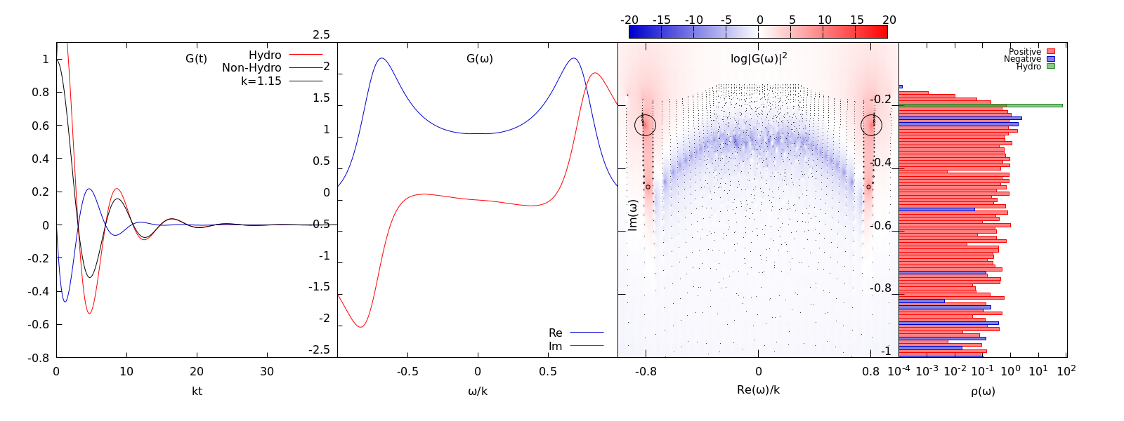
Possibility 3: Eigenvalues
Hydro poles wandering down
Overlay at some k causing uncertainty of residue
Hydro poles merge with non-Hydro area

Slide 22
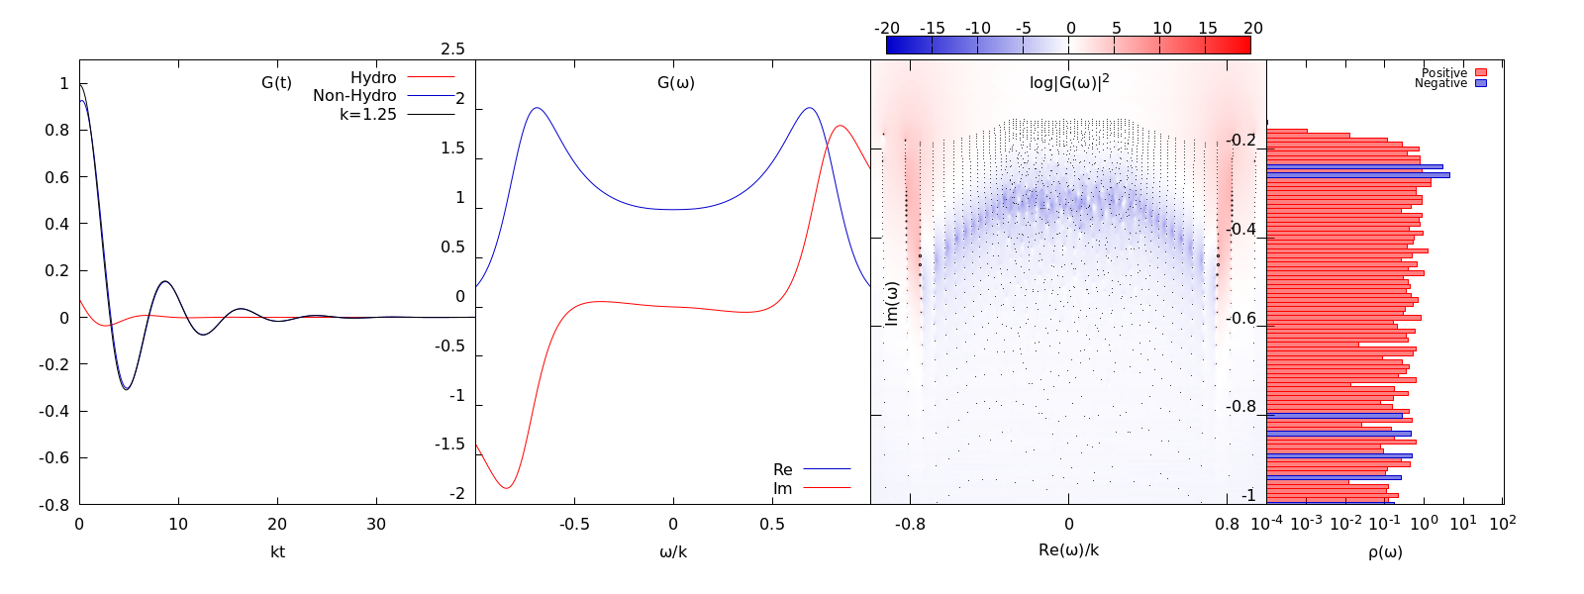
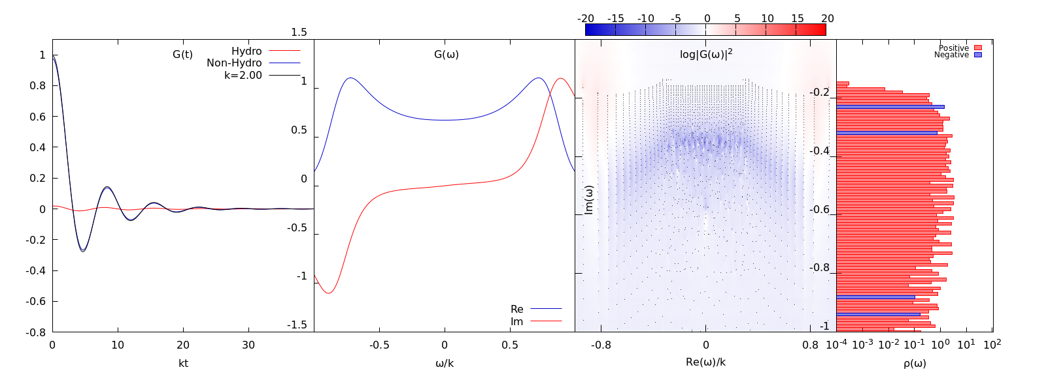
Possibility 3: Eigenvalues
No clear definition of Hydro possible
Contribution comes from huge area

Slide 23
Conclusion
Understanding non-Hydro modes helps finding the range of applicability of Hydro
Definition of what we call Hydro becomes blurry
Analytical structure of QCD Green’s functions expected to be more complicated than mere poles or cuts
Extend formalism to QCD kinetic theory

