Slide 1
Point Processes and
Multiple SLE/GFF Coupling
Lecture No.1 (8 Aug. 2022)
Dyson’s BM model (added)
Makoto KATORI (Chuo Univ., Tokyo)
4th ZiF Summer School
`Randomness in Physics and Mathematics:
From Integrable Probability to Disordered Systems'
ZiF-Center for Interdisciplinary Research,
Bielefeld University, Germany,
1-13 August 2022

Slide 2
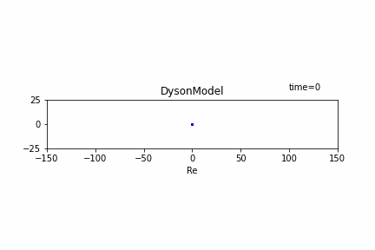
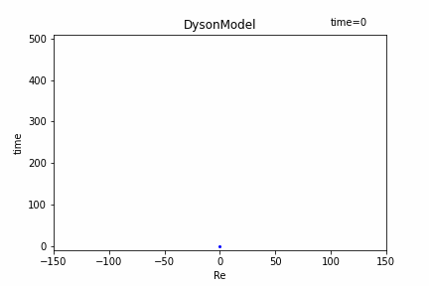
N =10 (given by S. Morimoto)

Slide 3
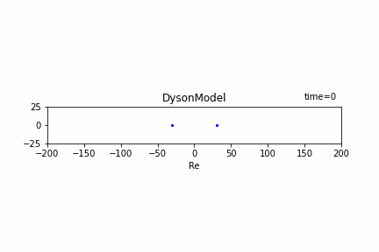

N =10 (given by S. Morimoto)

Slide 4
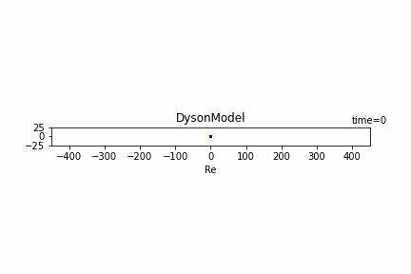
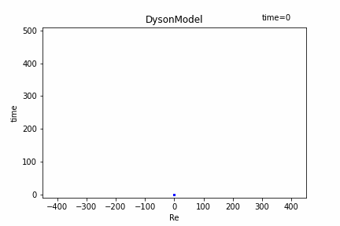
N =100 (given by S. Morimoto)

Slide 5
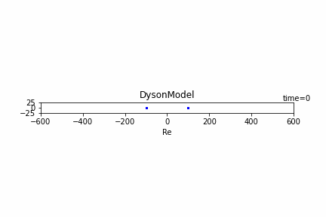

N =100 (given by S. Morimoto)

